Slide 1
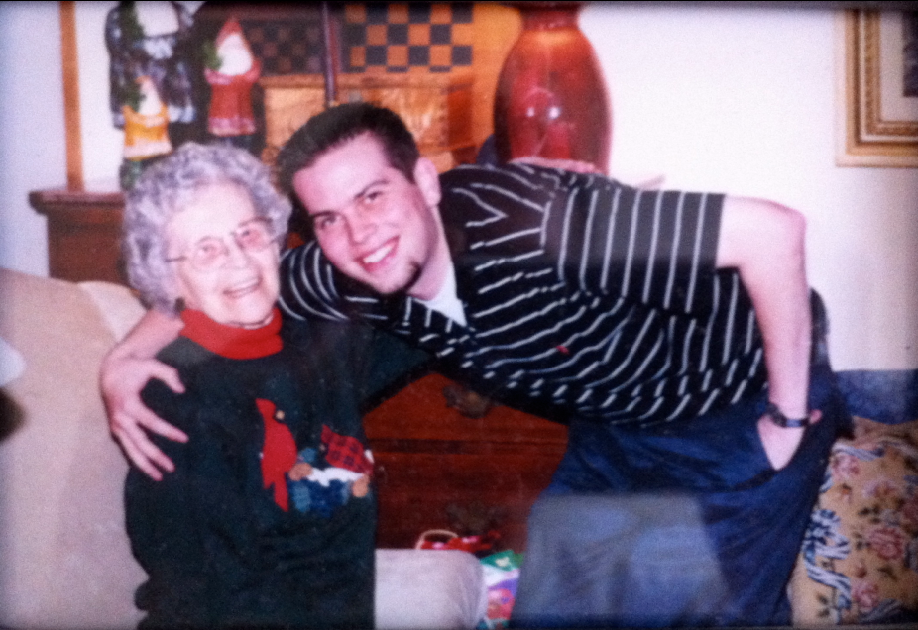
Spanning text and a landscape image
Shared introduction: compare the text with the image.
First: identify the main point.
Second: discuss the supporting evidence.
Shared caption: retain this below both columns.
Notes:
Controlled layout case. Image reused from the accessible pattern library. Expected: introduction, left text in top-to-bottom order, right image, full-width caption.

